Slide 1
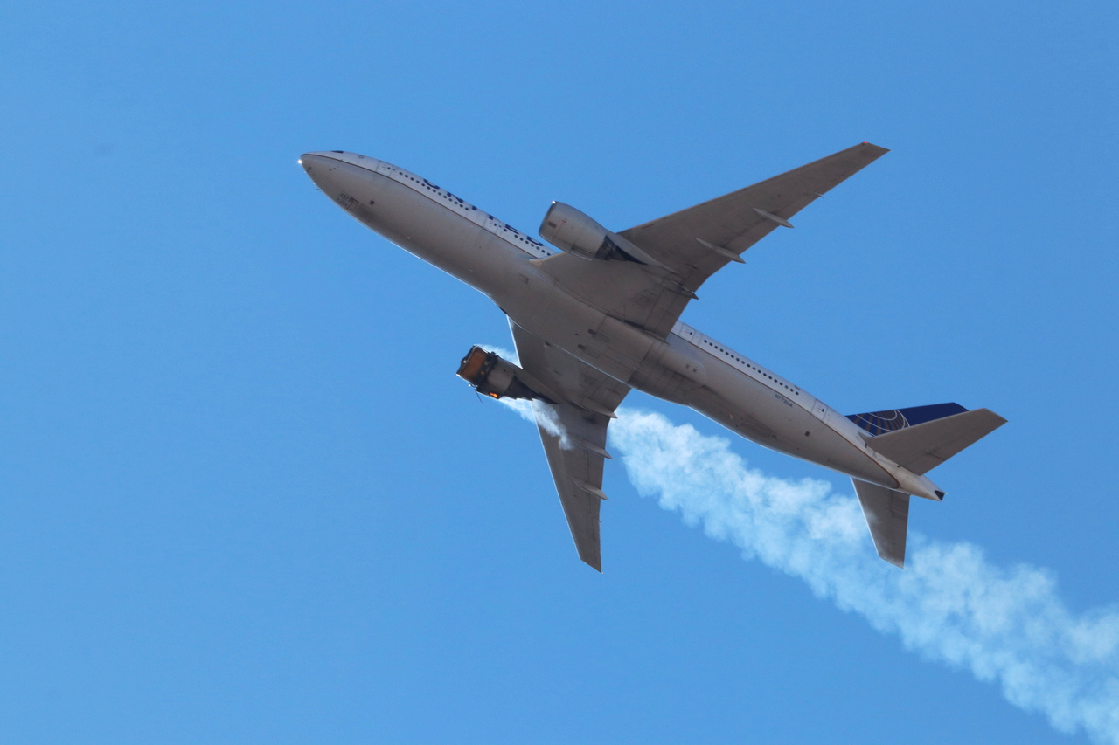
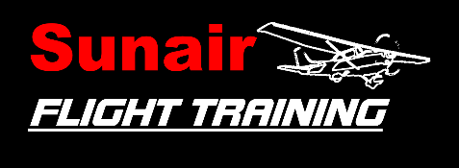
Engine Failure After Takeoff
Briefing copyrighted by Sunair Aviation Ltd.

Slide 2
Objectives
To adopt the recommended procedure in the event of engine failure at low level (below 1000ft AGL)

Slide 3
Considerations
Probable Causes
May be avoided by
Fuel Contamination
Fuel Starvation
Fuel Exhaustion
Carburettor Icing
Air Filter Blockage
Mechanical Failure
- Pre-Flight inspection
- Pre-flight planning, fuel system knowledge
- Awareness of fuel consumption
- Run up check, avoid prolonged idling,
Carb heat HOT
- Pre-flight inspection, alternate air (carb heat)
- Pre-flight inspection, run up check

Slide 4
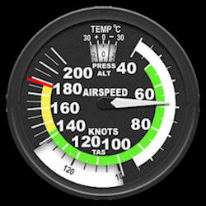
Considerations
Aborted Takeoff
Check for normal readings early on takeoff roll (T’s & P’s Green, Airspeed Alive)
Abort if any abnormality is experienced or if instructed by ATC
EFATO
Low Airspeed
High nose attitude
Low altitude
Landing site selection is limited
Aviate – Navigate – Communicate
-
-
-
-
-
-
-
… Very little time

Slide 5
Considerations
Go Around
Ends the simulation
Full power, raise the nose to the horizon to build up airspeed
Retract full flap before climbing out
Takeoff Safety Brief
Outlines intentions in the event of an engine failure during the takeoff
roll and after takeoff
-
-
-
-
Notes:
Should the engine fail before take off, close the throttle, apply the brakes and stop in the remaining runway. If the engine fails after take off, nose down, close throttle apply carb heat, find somewhere to land and FMI off if time permits.

Slide 6
Considerations
Landing Site Selection
Choose a landing site that is located in your forward field of view
There will be insufficient time to attempt a turn back towards the airfield
Notes:
Limit to no more than 45 degrees either side of the nose
For a familiar runway you should already have a landing site in mind in the event of an engine failure

Slide 7
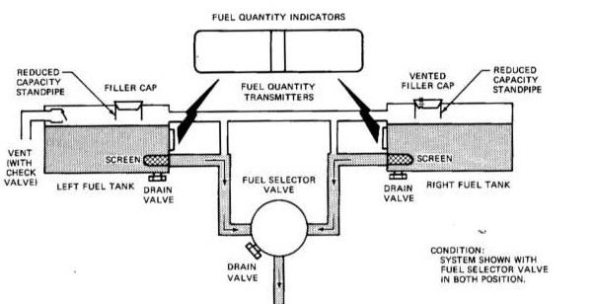
Aircraft Management
Systems Knowledge
Correct knowledge of fuel system can prevent starvation
Throttle
Smooth, positive use
Carb Heat
When throttle is closed
Airmanship
EFATO simulation commences with “simulating” – instructor will close throttle
Simulation ends with “go-around”
Touch checks
NO SOLO PRACTICE
Instructor advises ATC / Traffic
-
-
-
-
-
-
-
-

Slide 8
Human Factors
Situational Awareness
Fuel consumption and land by time
Information Processing
Pre takeoff safety brief
Stress
Over learn checks
Pre planning
Regular practice
Automatic reactions
Command decision making
-
-
-
-
-
-
IM SAFE

Slide 9
Air Exercise
Takeoff Safety Brief
Prior to line up
Aborted Takeoff
Aviate
Close throttle
Navigate
Keep Straight, Brakes as required
If over run likely F - Fuel selector off
M - Mixture idle cut off
I - Ignition off
Keep cabin intact
Communicate
Advise ATC / Traffic
-
-
-
-
-
-

Slide 10
Air Exercise
EFATO
AVIATE
FLY THE AEROPLANE : Lower nose and adopt best glide (65kts)
Close throttle
Carb Heat Hot
NAVIGATE
Follow takeoff safety brief
Choose landing site (ahead)
Within easy reach
Avoid MAJOR obstacles (keep cabin intact)
Use flap as required
-
-
-
-
-
-
-
-

Slide 11
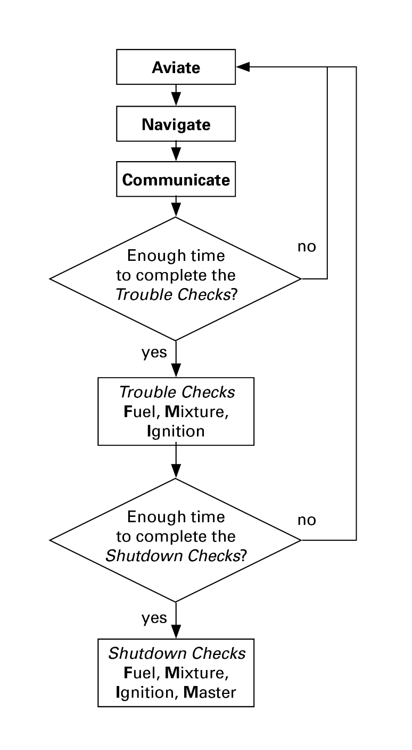
Air Exercise
If Time Permits
Trouble checks (touch checks)
F fuel pump on, change tanks, primer locked
M mixture rich
I ignition on both
Check for power
Shutdown Checks
F fuel selector off
M mixture idle cut off
I ignition off
COMMUNICATE
Mayday call
ELT On
Master OFF after using flap
-
-
-
-
-
-
-
-
-
Last Slide

