Slide 1
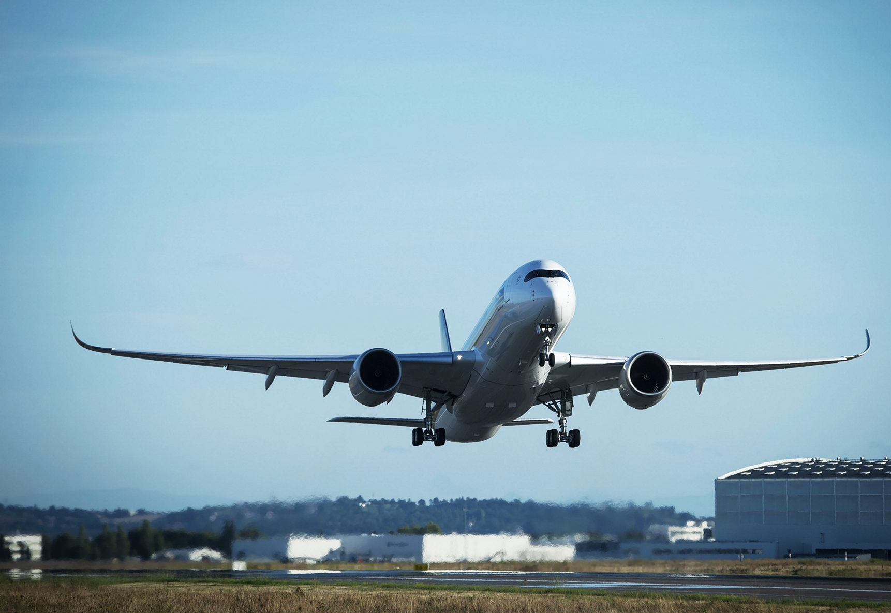
Climbing and Descending
Briefing copyrighted by Sunair Aviation Ltd.

Slide 2
Objectives
To enter the climb and descent from straight and level flight
To maintain a climb and a descent at a constant speed, rate, direction and in balance
To level off at preselected altitudes

Slide 3
Principles of Flight
Forces in a Climb
R2
L
T > D
T = D + RCW
L < W
RAF
T
D
W1
RCW
RCW
W
R1
Climb performance (ROC) depends on power available
Notes:
Since the aircraft is in equilibrium during the climb there must be a force equal and opposite to R1
What force controls the climb? Is there a limit to that force? How might that limit the climb?

Slide 4
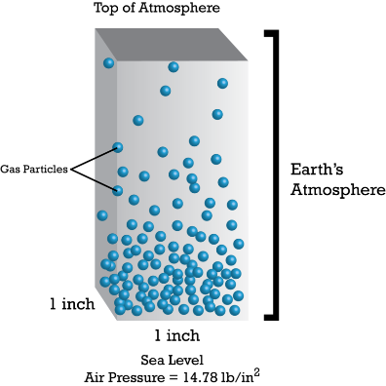
Principles of Flight
Factors Affecting the Climb
Absolute Ceiling
Power & Altitude
Increased power increases ROC and climb angle
Increased altitude reduces ROC and climb angle
Weight
Increased weight reduces ROC and climb angle
Flaps
Any use of flap increases drag and reduces ROC and climb angle
Wind
Headwind steepens climb angle
Tailwind shallows climb angle
ROC is unaffected
-
-
-
-
-
-
-
Wind
Climb path after 1 minute

Slide 5
Principles of Flight
Types of Climb
Cessna 172
A : Best Angle of Climb Vx 59kts
B : Best Rate of Climb Vy 78kts
C : Cruise Climb 80 - 90kts
B
A
C

Slide 6
Principles of Flight
Forces in a Glide Descent
R
L
D
FCW
W1
FCW
W
RAF
Notes:
The FCW balances drag to maintain the equilibrium.

Slide 7
Principles of Flight
Factors Affecting the Descent
Power
Increased power reduces ROD and descent angle
Range is increased
Lift/Drag Ratio
Determines glide angle
Weight
Increased FCW will increase airspeed and ROD
Angle and range unaffected
Flap
Increased drag requires increased FCW to maintain airspeed
ROD increases and range decreases
Wind
Headwind steepens descent angle
Tailwind shallows descent angle
ROD is unaffected
-
-
-
-
-
-
-
-
-
-
Wind
Descent path after 1 minute
Notes:
Power is used to control our ROD. Increase in power reduces our ROD.

Slide 8
Principles of Flight
Types of Descent
Cessna 172
A: Glide Descent Power idle, flaps up 65kts
B : Powered Descent 1500rpm, flap as required 65-70kts
C : Cruise Descent 2100rpm, flaps up 90kts
A
B
C

Slide 9
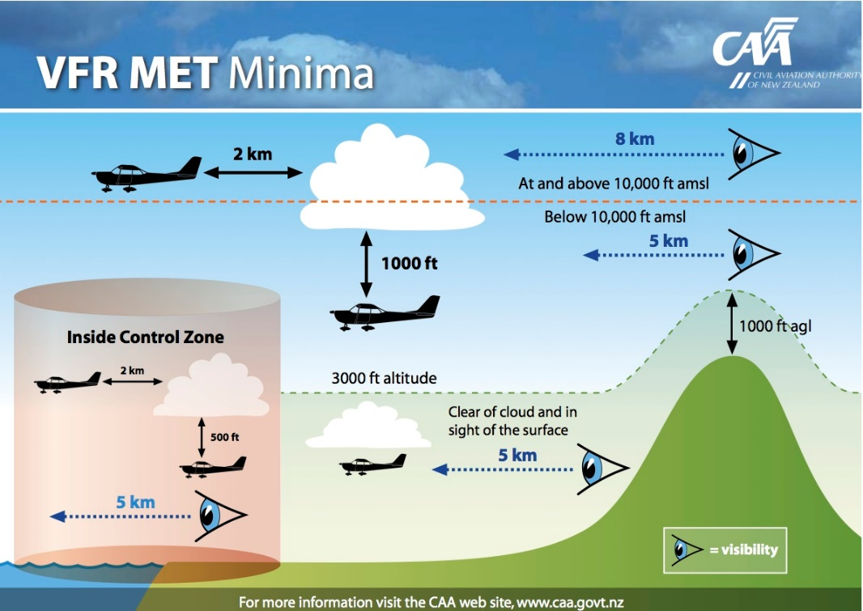
Aircraft Management
Climbing
Throttle
Full power or max continuous
Mixture
Full rich
Carb Heat
Cold
T’s & P’s
Normal (lower nose as required for cooling)
Climb Restrictions
Oxygen
Airspace
VFR (Visual Flight Rules)
Uncontrolled Aerodromes
600ft cloud ceiling
1500m visibility
-
-
-
-
-
-
-
-

Slide 10
Aircraft Management
Descending
Throttle
Advantages & Disadvantages
Mixture
Full rich
Carb Heat
Hot below rpm green range
T’s & P’s
Normal
Minimum Heights
500ft AGL over unpopulated areas
1000ft over populated areas plus enough
height to glide clear
-
-
-
-
-
-

Slide 11
Human Factors
Climbing
Altitude
Trapped gases in Sinuses
Flying after diving
Vision
Empty Sky Myopia
Noise Protection
High power settings
Lookout
Every 500ft using gentle ‘S’ turns
Situational Awareness
3-D Assessment
-
-
-
-
-
-

Slide 12
Human Factors
Descending
Altitude
Valsalva manoeuvre
Vision
Clean windscreen
Lookout
Sectored Scan
Gentle ‘S’ turns
-
-
-
-
IM SAFE

Slide 13
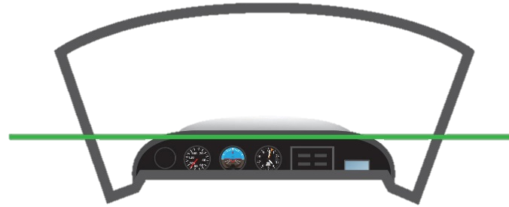
Air Exercise
Climbing
Entry
Ref point, Ref altitude, Lookout
Power - Apply full power (keep straight with rudder)
Attitude - Set and hold with elevator
- Wings level with ailerons
- Balance with rudder
Trim - Relieve control column pressure
-
PAT
Notes:
Power + Atitude = Performance

Slide 14
Air Exercise
Climbing
Maintain
Lookout - Gentle, balanced S turns every 500ft
- Traffic, Terrain, Cloud
Attitude - Maintain (change, check, hold, adjust, trim)
Instruments - Confirm performance (Altimeter, ASI, Balance ball)
Notes:
If airspeed is not correct then the attitude is not correct

Slide 15
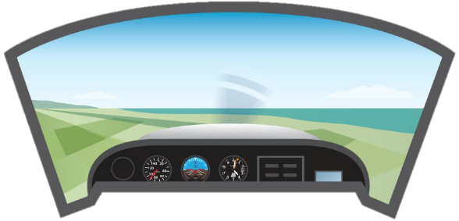
Air Exercise
Climbing
Exit
Anticipate by 20ft
Attitude - Smoothly select Straight & Level attitude
Power - Through 90kts decrease power to 2200rpm
Trim - As required to relieve control column pressure
APT
-

Slide 16
Air Exercise
Climbing
Demonstration
Best Angle of Climb & Best Rate of Climb
Note: Climb attitude and rate of climb
Effect of Flap on Climb Performance
Note: Lower nose attitude and decreased rate of climb
-
-

Slide 17
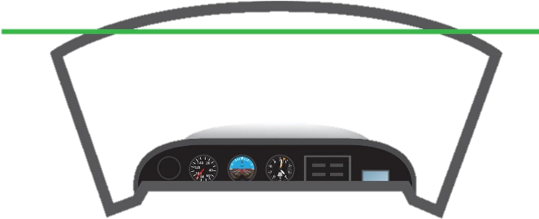
Air Exercise
Descending
Entry
Ref point, Ref altitude, Lookout
Power - Mixture rich, carb Heat hot
- Reduce power to 1500rpm (keep straight with rudder)
Attitude - Select and hold with elevator (70kts)
- Wings level with ailerons
- Balance with rudder
Trim - Relieve control column pressure
-
PAT

Slide 18
Air Exercise
Descending
Maintain
Lookout - Gentle, balanced S turns every 500ft
- Traffic, Terrain, Cloud
Attitude - Maintain (change, check, hold, trim)
Instruments - Confirm performance (Altimeter, ASI, Ball)

Slide 19
Air Exercise
Descending
Exit
Anticipate by 50ft
Power - Carb Heat cold
- Smoothly increase to 2200rpm (keep straight with rudder)
Attitude - Smoothly select Straight & Level attitude
Trim - As required to relieve control column pressure
-
PAT

Slide 20
Air Exercise
Descending
Demonstration
Effect of Power on Descent Performance
At a constant airspeed power affects the angle and rate of descent
Effect of Flap on Descent Performance
At a constant airspeed flap affects the angle and rate of descent
-
-
Last Slide

