Slide 1
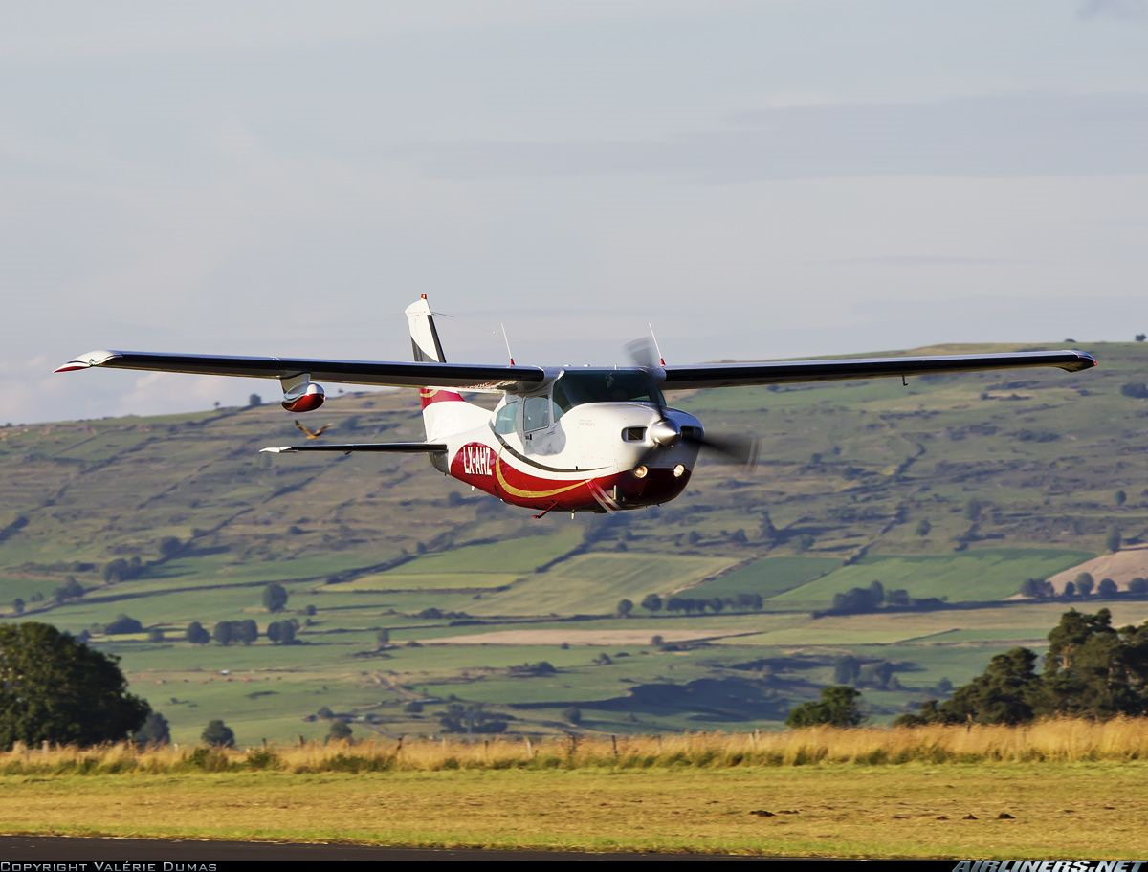

Low Flying Introduction
Briefing copyrighted by Sunair Aviation Ltd.

Slide 2
Objectives
To compensate for the effects of visual illusions, inertia, and stress when operating an aeroplane close to the ground
Introduce the poor visibility configuration

Slide 3
Considerations
Inertia
Inertia and sense of speed most apparent at low level
At normal cruise speed the degree of anticipation and turn radius is
substantial
Poor Visibility Configuration
70kts, 10 - 20⁰ flap
Reduced airspeed = More time to react & less turning radius
Flap = Decreased stall speed
Power about 2000rpm (monitor T’s & P’s if configuration prolonged)
Carb heat as required
-
-
-
-
-
-

Slide 4
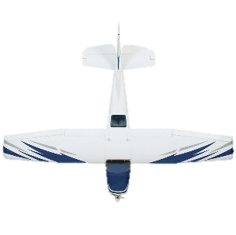
Considerations
Visual Effects
Wind can create numerous visual effects
-
Headwind: Low groundspeed, avoid lowering the nose or
increasing power
Tailwind: High groundspeed, avoid raising nose or
reducing power
Crosswind: Noticeable drift, track a reference point and
avoid crossing controls

Slide 5
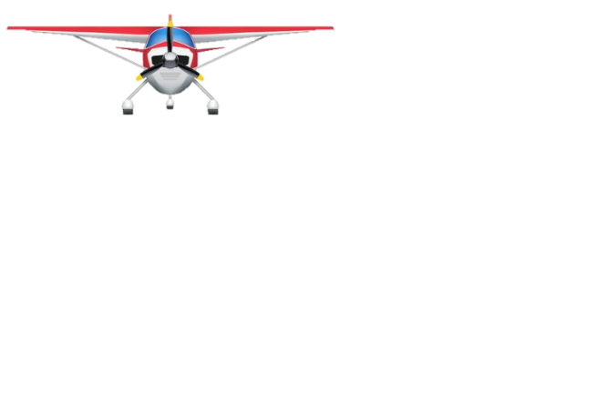
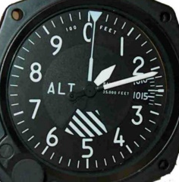

Considerations
Visual Effects While Turning
Avoid correcting with rudder
Cross-reference with balance ball
Flight Over Calm Water
Difficulty determining depth perception
Refer to altimeter
-
-
Apparent Skid out
Apparent Slip in
-
-

Slide 6
Aircraft Management
Low Flying Zone (LFZ)
Refer to VNC
L264, L265
Minimum Altitude 200ft AGL
Poor Visibility Configuration
70kts, 10 - 20⁰ flap, power as required
Loosen throttle friction
HASELL+L Prior to Entry
Radio Calls
Report intentions prior to entry
Report prior to vacating
Carb Heat
Cycle regularly
Fuel Management
Flaps increase drag and reduced range
-
-
-
-
-
-
-
-
HASELL+L Check

Slide 7
Human Factors
Stress
Flying low level can increase stress
Poor visibility configuration gives more time
Remain calm and avoid fixation
Vision
Obstructions difficult to see at low level (wires, birds)
Be aware of the visual illusions
Situational Awareness
Think ahead, understand the weather conditions for the day
Avoid bad weather
-
-
-
-
-
-
-
IM SAFE

Slide 8
Air Exercise
Familiarisation of LFZ Boundaries
Complete HASELL+L check prior to entry
Enter LFZ using a powered descent
Fly around the LFZ boundaries
Visual Illusions
Regain S&L not below 300ft AGL at cruise speed
Observe the effects of inertia and the reaction time required
3-D effect – obstacles more noticeable at low level
Note the effects that wind has on turning
Note the effect of wind on groundspeed
-
-
-
-
-
-
-
-

Slide 9
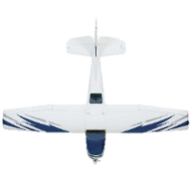
Air Exercise
Poor Visibility Configuration
Reduce power and slow the aircraft while maintaining height
Lower flaps below 85kts
Maintain S&L at 70kts and trim
Note the slower speed gives more time to react
Wind Effects & Illusions
Fly in a racecourse pattern in the poor visibility configuration
-
-
-
-
-
Groundspeed Higher
Apparent Slip
Apparent Skid
Groundspeed Lower
Last Slide

Slide 10
HASELL+L Check
HASELL+L Check
Height - Nominate minimum descent height
Airframe - State the configuration (flaps up/down)
Security - Hatches and harnesses secure, no loose items, Life jackets
Engine - T’s & P’s Green Range, Mixture full rich, Fuel
Location - Within LFZ boundaries
Lookout - LFZ clear of traffic, wind direction
Lights - All exterior lights on
Return

