Slide 1
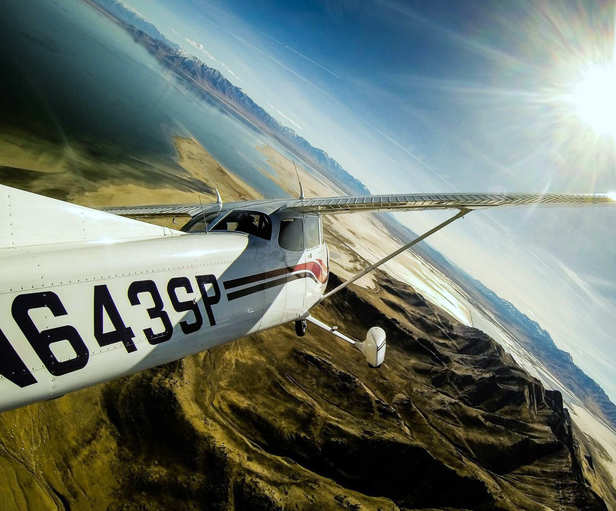
Medium Turns
Briefing copyrighted by Sunair Aviation Ltd.

Slide 2
Objectives
To change direction through 360˚ at a constant rate, using 30˚ angle of bank, while maintaining a constant altitude and keeping the aeroplane in balance
To complete a medium turn while climbing and descending

Slide 3
Principles of Flight
Forces in a Turn
L
L
VCL
VCL = W
HCL = CPF
W
To maintain a level turn lift must be increased, this is done by increasing the angle of attack

Slide 4
Principles of Flight
Adverse Yaw
L
L

Slide 5
Principles of Flight
Adverse Yaw
RAF
L
Roll
Up-going Wing
L

Slide 6
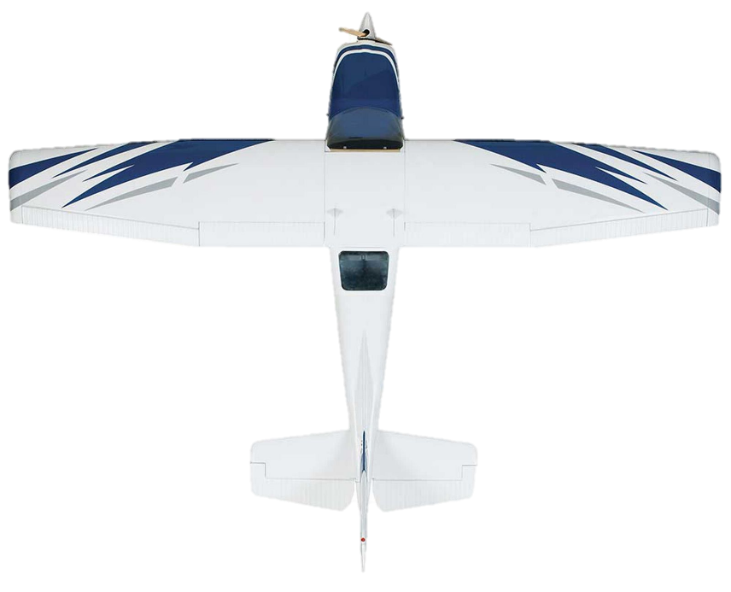
Principles of Flight
Adverse Yaw
RAF
RAF
Down-going Wing
Roll
Up-going Wing
D
D

Slide 7
Principles of Flight
Adverse Yaw
RAF
RAF
Down-going Wing
Roll
Up-going Wing
Yaw
Balance with Rudder

Slide 8
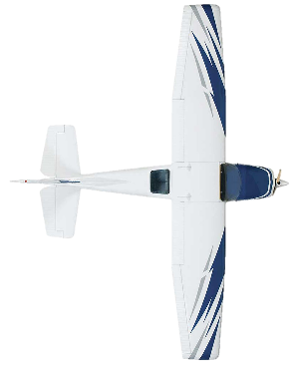
Principles of Flight
Overbanking
The outer wing travels a further distance than the inner wing in the same time period
As a result, this wing is travelling faster and will produce more lift causing the aircraft to continue rolling into the turn

Slide 9
Principles of Flight
Overbanking in a Climbing Turn
Outer Wing Flight Path
Inner Wing Flight Path
Altitude Gain
Horizontal distance travelled
Note: Climb performance reduces with increasing bank angle
(max 20° during climb)
Since the outer wing has a greater angle of attack it produces more lift creating a tendency to overbank
Hold off with aileron

Slide 10
Principles of Flight
Underbanking in a Descending Turn
Altitude Loss
Outer Wing Flight Path
Inner Wing Flight Path
Horizontal distance travelled
Since the inner wing has a greater angle of attack it produces more lift creating a tendency to underbank
Maintain Bank Angle With Aileron

Slide 11
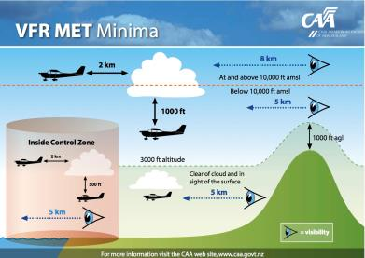
Aircraft Management
SCADIE
Cruise check: Complete at Top of Climb and
regularly during flight
Lookout
20°every 2 seconds
Prior to and during turns
Airspace
Vertical and lateral limits (drift)
Taxi Check
Turn/Skid, Turn, Level, Turn (both
directions)
Check Brakes
VFR Minima
Controlled airspace
-
-
-
-
-
-

Slide 12
Human Factors
Disorientation
Select a large reference point
Situational Awareness
Lookout and Listen out
Consider current weather conditions
Resisting Bank
Pilot tendency to sit up straight or reduce angle of bank
-
-
-
-
IM SAFE

Slide 13
Air Exercise
Taxi Check
Turn/Skid, Turn, Level, Turn
Adverse Yaw
Demonstration
Roll into turn with aileron, no rudder. Note yaw in opposite direction to roll
-
-

Slide 14
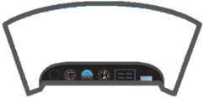
Air Exercise
The Medium Turn
Entry
Ref point, Ref altitude, Lookout
Roll in smoothly with Aileron
Balance with Rudder
Set attitude with Elevator
Check 30⁰ angle of bank
-
}
-
-
-
Coordinate (eyes outside)
-
Effect of side by side seating on attitude

Slide 15
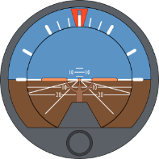
Air Exercise
The Medium Turn
Maintain
Lookout – Traffic, airspace, cloud, reference point
Attitude – Confirm correct, 30⁰ AoB
Instruments – Confirm performance
(Altitude, bank angle, balance ball)
30º

Slide 16
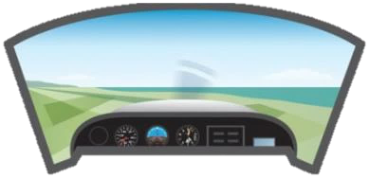
Air Exercise
The Medium Turn
Exit
Anticipate reference point by ½ AoB
Roll out smoothly with Aileron
Balance with Rudder
Set S&L attitude with Elevator
Check PAT
-
}
-
-
-
Coordinate (eyes outside)
-

Slide 17
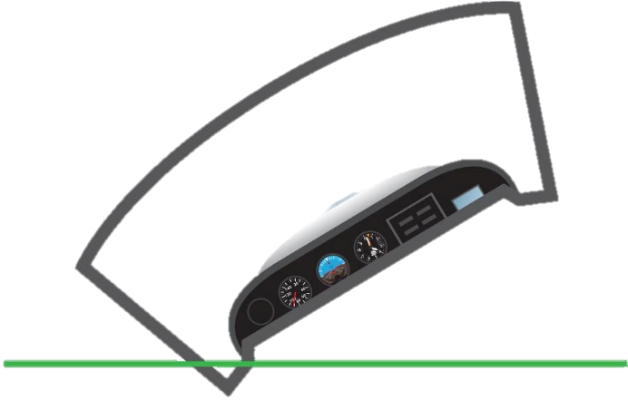
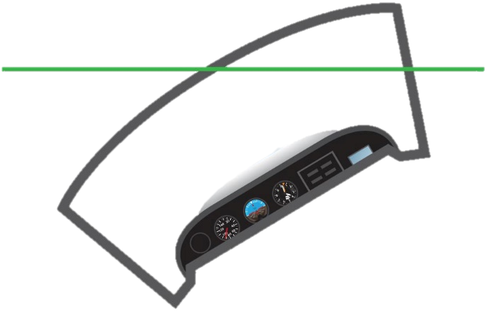
Air Exercise
Climbing Turns
Ref point, Ref Altitude, Lookout
Establish cruise climb at 80kts
Roll in with aileron, Balance with rudder
Limit AoB to 20°
Tendency to continue rolling into turn – hold off with aileron
Descending Turns
Ref Point, Ref altitude, Lookout
Establish powered descent at 70kts
Roll in with aileron to 30° AoB, Balance with rudder
Relax back pressure to maintain 70kts
Tendency to roll out of turn – hold on with aileron
-
-
-
-
-
-
-
-
Last Slide

