Slide 1
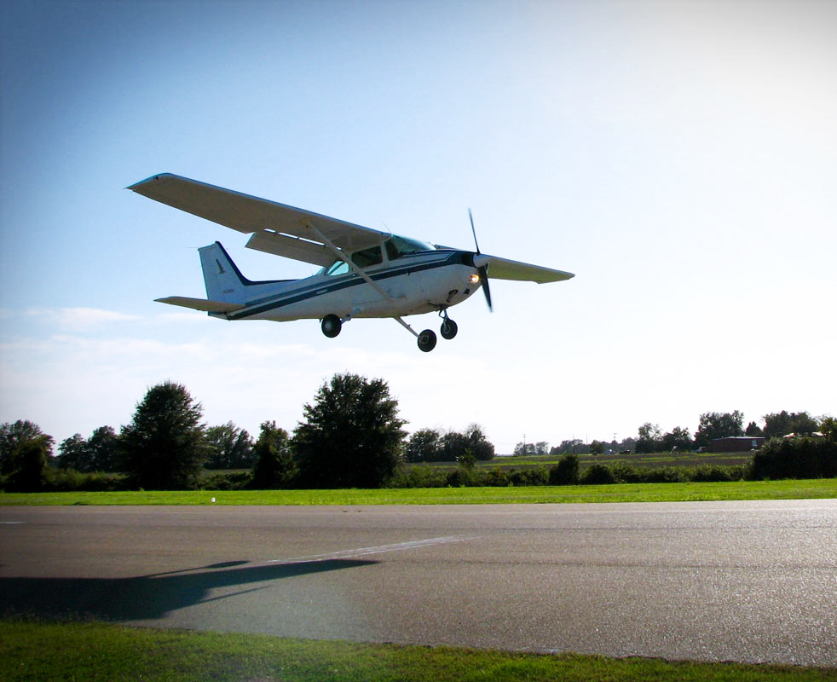
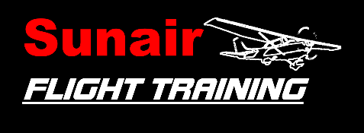
Circuit Introduction
Briefing copyrighted by Sunair Aviation Ltd.

Slide 2
Objectives
To takeoff and follow published procedures that conform to the aerodrome traffic circuit, avoiding conflict with other aircraft
To carry out an approach and landing using the most suitable runway

Slide 3
Considerations
Takeoff
Power
Use full power for takeoff
Swing on Takeoff
Slipstream
Torque
Both effects cause aircraft to yaw left when power is applied
Keep straight on reference point with rudder
Flap
Increases lift and drag
Aircraft flight manual specifies ideal flap setting
-
-
-
More Friction
-
-

Slide 4
Considerations
Takeoff
Wind
Headwind - Shorter ground roll
- Steeper angle of climb
- Better obstacle clearance
Tailwind - Greatly increased ground roll
- Shallow angle of climb
- Reduced obstacle clearance
Crosswind - Aircraft tends to “weathercock”

Slide 5
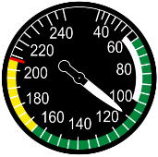
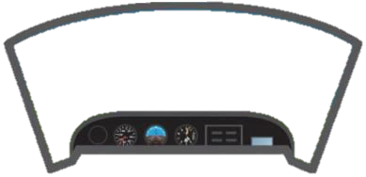
Considerations
Approach & Landing
Power
Controls rate of descent
Nose Attitude
Controls airspeed
Flap
Increased lift reduces Vs allowing lower approach speed = Shorter ground roll
Increased drag gives lower nose attitude for same airspeed = Better visibility
The steeper approach gives better obstacle clearance
-
-
-
-
-
Note: Use brakes as required depending on runway length available
- Brakes off during landing!

Slide 6
Considerations
Landing
Wind
Headwind - Shorter ground roll
- Steeper angle of descent
- Better obstacle clearance
Tailwind - Greatly increased ground roll
- Shallow angle of descent
- Reduced obstacle clearance

Slide 7
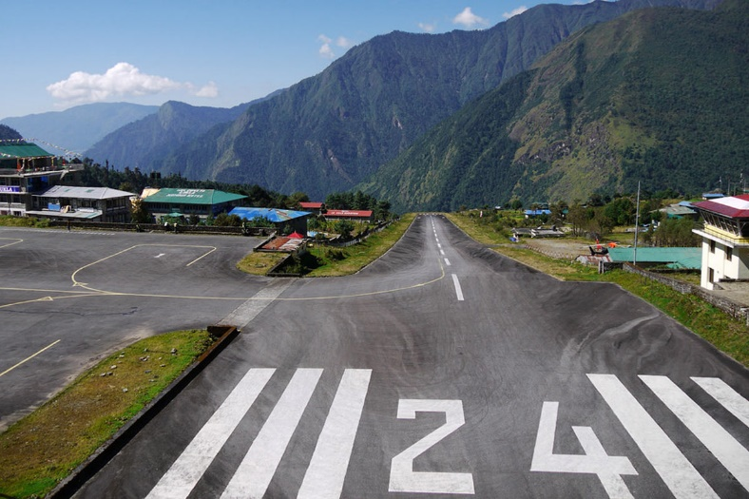
Considerations
Runway Slope
Takeoff
Uphill - Slow acceleration
- Shallow climb angle
- Reduced obstacle clearance
Landing
Uphill - Steeper angle of descent
- Better obstacle clearance
- Fast deceleration

Slide 8
Considerations
Runway Slope
Takeoff
Downhill - Fast acceleration
- Steeper angle of climb
- Better obstacle clearance
Landing
Downhill - Shallow angle of descent
- Reduced obstacle clearance
- Slow deceleration

Slide 9
Aircraft Management
Right of Way Rules (ROW)
Aircraft landing have ROW over aircraft taking off
Aircraft in circuit have ROW over aircraft joining
Follow at a safe distance, do not overtake or cut in front of other aircraft
All turns in circuit direction
Circuit height 1000’ AGL (unless stated otherwise)
SCADIE Check
Monitor gauges during circuits
-
-
-
-
-
-

Slide 10
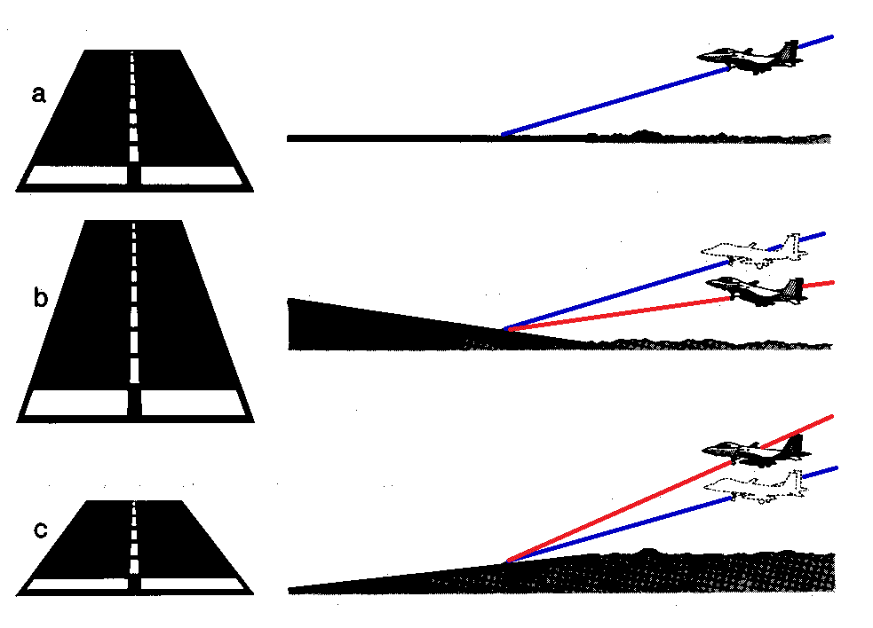
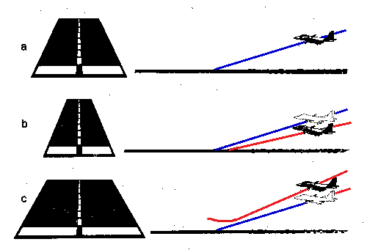
Human Factors
Vision
Runway perspective - Different on sloping runway
- Changes with runway width
Information Processing
Increased workload
Regular practice
Mnemonics (e.g. Pre-landing checks)
Airmanship
Command Decision Making
Situational Awareness
Lookout and listen out
Wind direction
-
Runway Slope
Nil slope on profile
Upsloping runway
Downsloping runway
Runway Width
Normal Width
Narrow Runway
Wide Runway
-
-
-
-
-
-
IM SAFE

Slide 11
Air Exercise
1. Lineup checks
2. After takeoff checks (above obstacles)
3. Check tracking
- Commence downwind turn at approximately 800 - 1000ft
4. Downwind/Pre-landing checks
5. Check and note spacing
- Downwind radio call
6. Carb heat Hot
- Reduce power to 1500rpm
- Keep straight, maintain altitude
- White arc, lower 10° flap
- Set attitude for 75kts, hold and trim
7. Check tracking
- Lower 20 °flap
- Set attitude for 70kts
8. Anticipate centreline
- Commence turn so as to roll out on centreline at 500ft AGL
9. Full flap (as appropriate)
- Carb heat cold
- Use power to control rate of descent and approach
- Set attitude for 65kts
3
Lookout
Crosswind
Lookout
Min 500ft AGL
4
Up wind
1000ft
2
5
Downwind
6
1
CENTRELINE
PROFILE
SPEED
9
45° nil wind
Final
Lookout
7
Base
8
Lookout

Slide 12
Air Exercise
Correct Landing Technique
Aiming Point
Initial reference
Below 50ft, focus on far end of runway
-
-
Power Off
Level Off
Touch Down
Hold Off
65 Knots
at
50 ft

Slide 13
Air Exercise
Incorrect Landing Technique
…Too Fast
Indications
Low nose attitude
Aircraft tends to float
-
-
Go Around

Slide 14
Air Exercise
Incorrect Landing Technique
…Too Slow
Indications
High nose attitude
Aircraft tends to sink
-
-

Slide 15
Air Exercise
Correct Landing Technique
Power Off
Level Off
Touch Down
Hold Off
65 Knots
at
50 ft

Slide 16
Air Exercise
Touch & Go
Gently lower nose wheel after touchdown
Raise flaps to take-off setting (0⁰)
Smoothly apply full power (keep straight)
Continue as per a normal take-off
-
-
-
-
Last Slide

