Slide 1
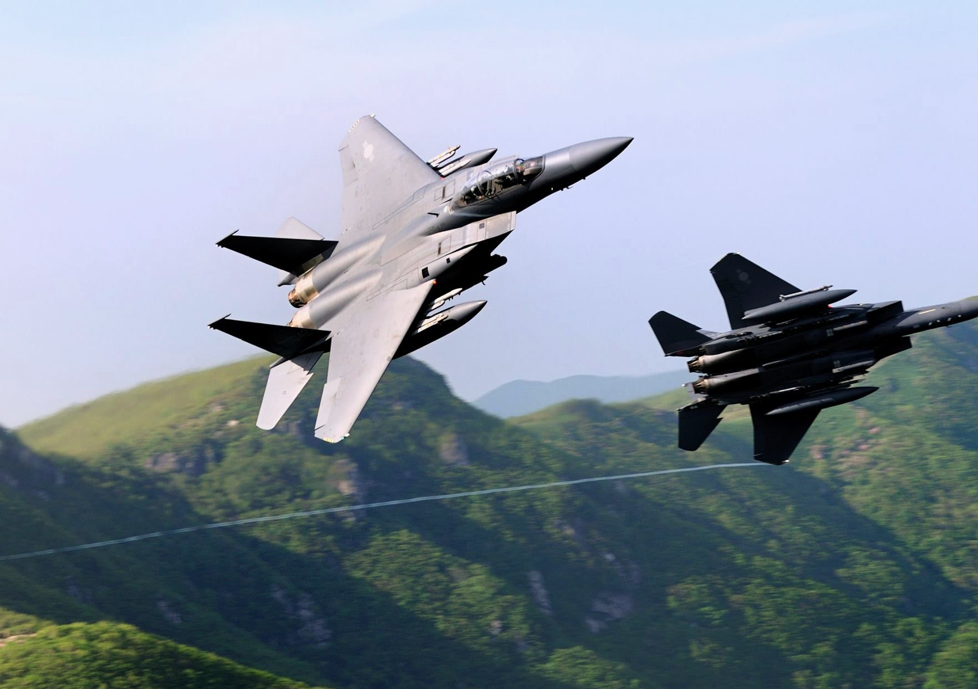
Steep Turns
Briefing copyrighted by Sunair Aviation Ltd.

Slide 2
Objectives
To change direction through 360 degrees, using 45 degrees angle of bank, maintaining a constant altitude and in balance
To become familiar with the sensations of high bank angles and high rates of turn

Slide 3
Principles of Flight
L
VCL = W
L
L
Lift doubled
HCL = CPF
W
W
W
30°
45°
60°
During a level turn lift has to be increased to keep the vertical component of lift equal to weight
In a level turn lift by AoA, which drag and Airspeed

Slide 4
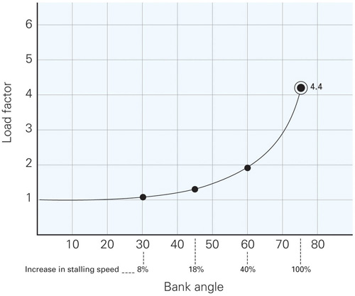
Principles of Flight
Load Factor
Also known as ‘Apparent weight’ or ‘G’
LF with an in lift requirement (L ÷ W)
Thus LF increases with angle of bank
LF vs Stall speed
As LF increases, Vs (stall speed) increases due to increased
lift requirement
‘K’
L = AoA x Airspeed
New Vs = Basic Vs x √LF
LF = 1/Cos45 = 1.41
New Vs = 49 x √1.41 = 58kts (18% increase)
-
-
-
-
-

Slide 5
Principles of Flight
Power Sandwich
During the turn, drag reduces airspeed, while LF increases Vs
Power is needed to avoid stalling
-
-
Airspeed
Power
Stall speed

Slide 6
Principles of Flight
Adverse Yaw
Amount of rudder depends on rate of roll
Low airspeeds require more aileron deflection, thus more adverse yaw
Balance with rudder
Rudder in a steep turn
During a steep turn, rudder can pitch the nose above or below the horizon
Maintain altitude with elevator
-
-
-
-
Adverse Yaw

Slide 7
Principles of Flight
Spiral Dive
Caused by overbanking
Symptoms
High AoB, high RoD, increasing airspeed, increasing ‘G’
Prevented By
Maintaining AoB with aileron
Counteracting secondary effects of rudder
-
-
-
-

Slide 8
Aircraft Management
SCADIE
Complete regularly during flight
Taxi Check
Turn, Skid, Turn, Level, Turn
Power
Increase RPM through 30° AoB (100RPM/Audible increase)
Airmanship
Minimum altitude - when practicing steep turns (1,500ft)
VFR Minima (5-2-5 in CTR)
Sick bags on board
-
-
-
-
-
-

Slide 9
Human Factors
Disorientation
Prominent reference point
Vision
Lookout prior to and during turns
Effects of ‘G’ forces
Stress
Could be uncomfortable at first
Overcome with exposure and practice
Speak up if uncomfortable
-
-
-
-
-
-
IM SAFE

Slide 10
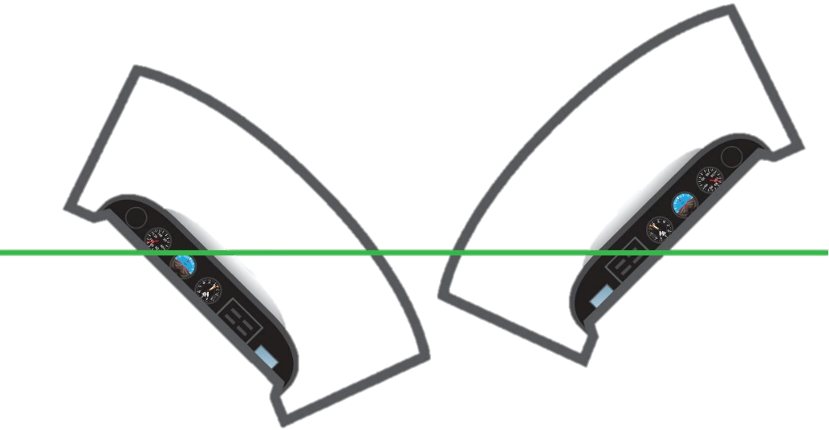
Air Exercise
Steep Turn
Entry
Reference point, Reference altitude, Lookout
Roll with aileron
Balance with rudder
Through 30⁰ AoB increase power
Increase backpressure
Check 45⁰ AoB
Reduce rudder pressure to maintain balance
-
-
-
-
-
-
-
}
Coordinate (eyes outside)
Effect of side by side seating on attitude

Slide 11
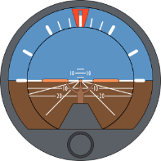
Air Exercise
Steep Turn
Maintain
Lookout – Traffic, airspace, cloud, reference point
Attitude – Confirm correct, 45⁰ AoB
Instruments – Confirm performance
(Altitude, bank angle, balance ball)
45º

Slide 12
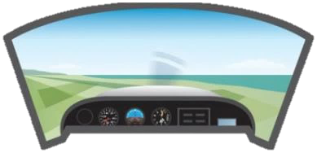
Air Exercise
Steep Turn
Exit
Anticipate reference point by ½ AoB
Roll out with Aileron
Balance with Rudder
Relax back pressure
Reset S&L attitude
Through 90kts reset 2200rpm
Check PAT
-
-
-
-
-
-
-
}
Coordinate (eyes outside)

Slide 13
Air Exercise
Spiral Dive
Instructor Demonstration
Overbanking during entry
Recovery
Close throttle
Level the wings
Gently ease out of the dive (caution Vne)
Note: Failure to level the wings prior to pull up, will result in pulling further into the dive
-
-
-
-
Last Slide

Slide 14
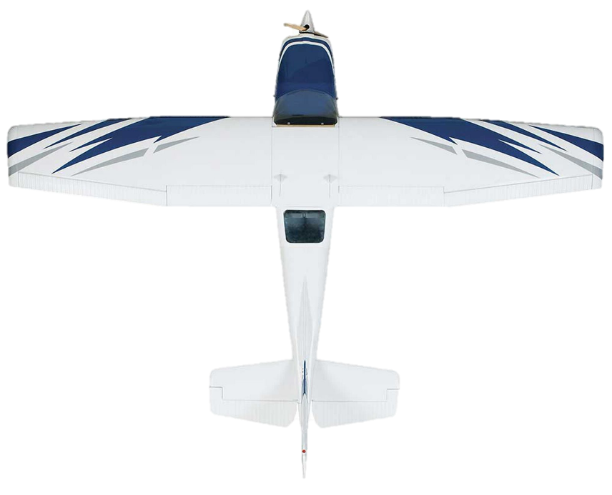
Adverse Yaw
RAF
RAF
Down-going Wing
Roll
Up-going Wing
Yaw
D
D
Return

